Slide 1
Lightweight Deep Learning Model Architecture
for Affective State Recognition from Wearable Physiological Sensors
Indrajeet Mondal · Susmita Bera · Rajeev Nayan
Project Guide: Suseta Datta
Dept. of Computer Application, Narula Institute of Technology, Kolkata, India
Wearable Sensors
Affective Computing
CNN-BiGRU
Stress Detection
LOSO Validation
Dataset: WESAD | Subjects: 15 | Classes: 4

Slide 2
Presentation Outline
01
Motivation & Problem Statement
06
Training Strategy
Why lightweight affective computing matters
LOSO, class balancing, AdamW, AMP
02
Dataset: WESAD
07
Results: Baseline Model
Multi-modal wearable physiological signals
Accuracy, F1, confusion matrix
03
Exploratory Data Analysis
08
Results: Balanced Sampling
Class distribution, UMAP, raw signals
Improvement in minority class detection
04
Data Preprocessing Pipeline
09
Baseline vs. Balanced Comparison
Windowing, alignment, normalization
Side-by-side metric analysis
05
Model Architecture
10
State-of-the-Art Comparison
CNN → BiGRU → Attention → Classifier
Positioning vs. published WESAD methods

Slide 3
Motivation & Problem Statement
Post-COVID Mental Health Crisis
Our Solution
1
Rising stress, anxiety & depression — continuous monitoring is critical
✓ Lightweight CNN-BiGRU (~1.2M params)
Smart Wearables Lack Intelligence
✓ 70–85% fewer params vs CNN-LSTM
2
Devices collect data but lack predictive affective insights
✓ Multi-head self-attention for key moment focus
Heavy Models, Poor Deployability
3
✓ Strict 4-class LOSO evaluation
CNN-LSTM models (2M–6M params) too large for edge wearables
✓ WeightedRandomSampler for class balance
Class Imbalance Challenge
4
✓ 35–40% faster training than BiLSTM
Baseline dominates (~65–75%); minority states hard to detect

Slide 4
Dataset: WESAD
15
4
~700 Hz
~32 Hz
8
Subjects
(S2–S17)
Affective
States
Chest
(RespiBAN)
Wrist
(Empatica E4)
Signal
Channels
Physiological Channels Used
4 Affective States
Channel | Source | Signal Type
wr_acc_mag | Wrist | Accelerometer Magnitude
wr_eda | Wrist | Electrodermal Activity
wr_temp | Wrist | Skin Temperature
ch_ecg | Chest | Electrocardiogram
ch_resp | Chest | Respiration
ch_acc_mag | Chest | Accelerometer Magnitude
ch_eda | Chest | Electrodermal Activity
ch_temp | Chest | Skin Temperature
Channel
Source
Signal Type
Baseline
Neutral resting state (~65–75% of data)
Stress
TSST protocol induced (~10%)
Amusement
Funny video clips (~6%)
Meditation
Guided meditation (~12%)

Slide 5
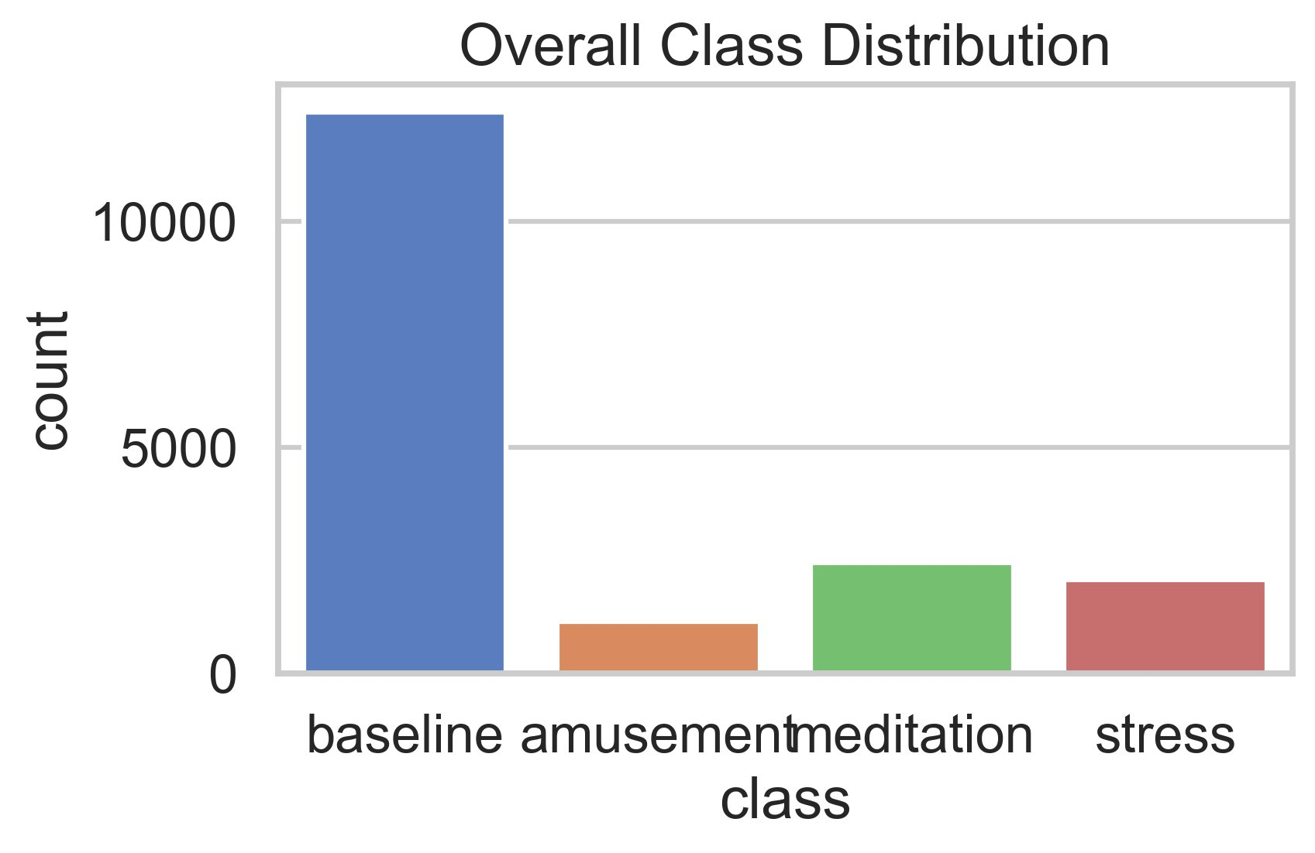
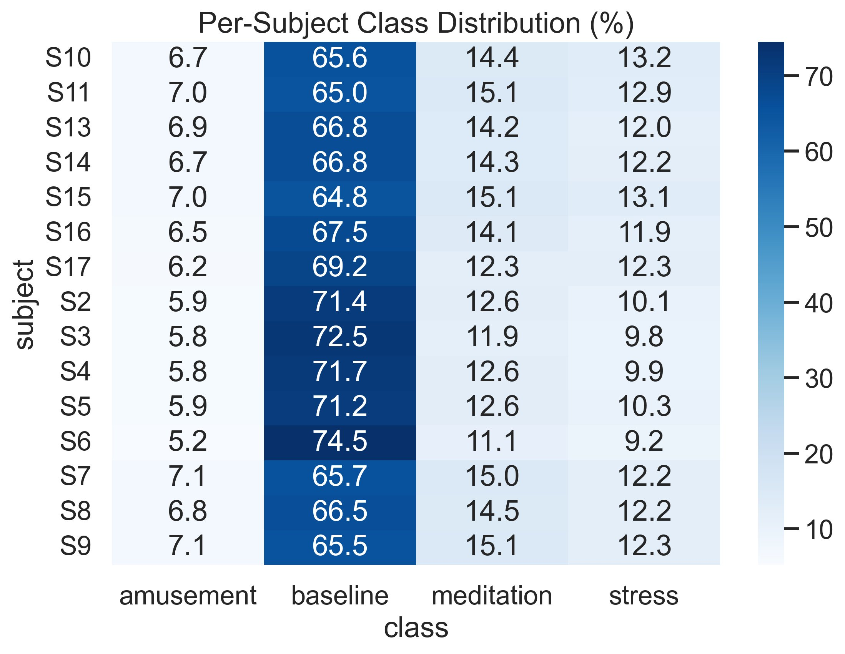
Exploratory Data Analysis — Class Distribution
Severe Imbalance
Consistent Pattern
Baseline: ~12,000 samples vs others: ~1,000–2,500
All 15 subjects show the same imbalance ratio

Slide 6
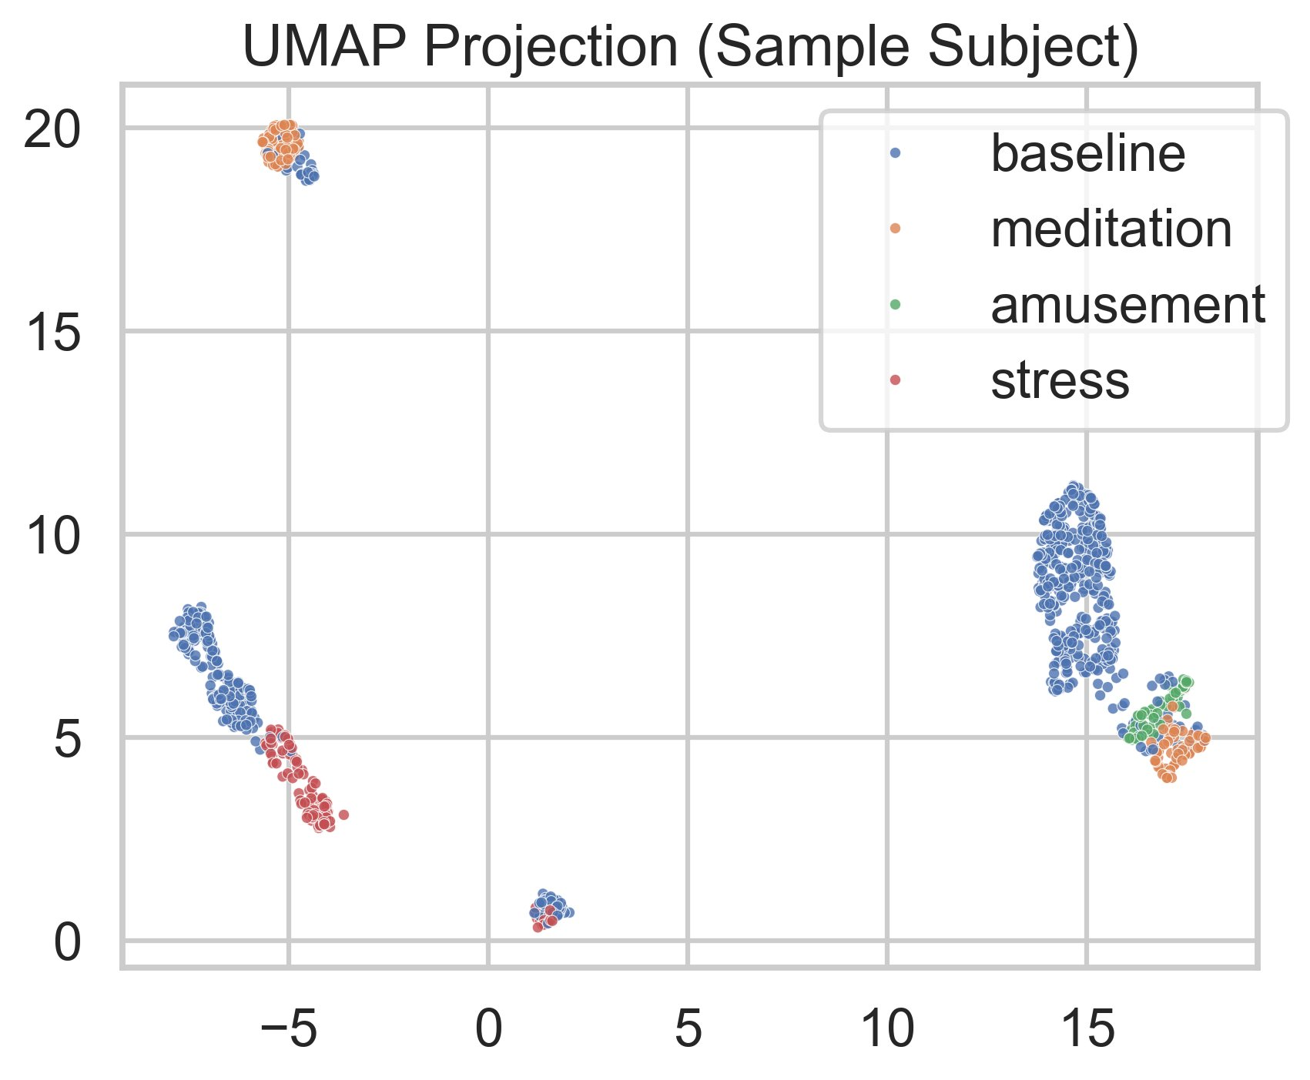
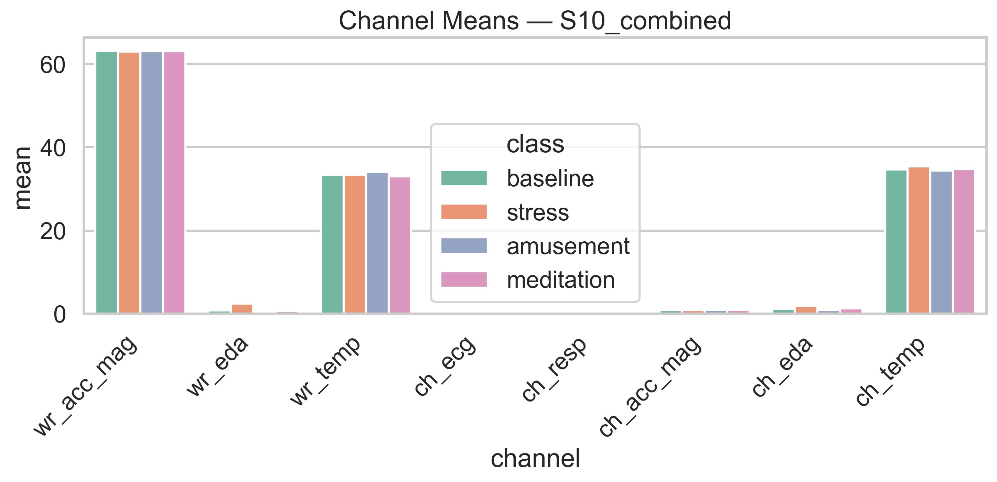
Exploratory Data Analysis — Signal Patterns
UMAP Projection (Sample Subject)
Channel Means per Class (S10)
Key Observation: wr_acc_mag and wrist/chest temperature channels show consistent mean values across all affective states — suggesting these act as background physiological signals. EDA channels show the most class-discriminative variation, consistent with physiological literature.
UMAP reveals moderate class separability — 4 distinct clusters with partial overlap between meditation and amusement, confirming classification difficulty.

Slide 7
Data Preprocessing Pipeline
Step 01
Step 02
Step 03
Load Raw .pkl Files
Upsample Wrist Signals
Compute ACC Magnitude
Chest @ ~700 Hz (ECG, EDA, Resp, Temp, ACC)
Wrist @ ~32 Hz (EDA, Temp, ACC)
Linear interpolation to match chest sampling rate; grids normalised to [0,1]
3-axis (x,y,z) → scalar: √(x²+y²+z²)
Applied to both chest and wrist sensors
Step 04
Step 05
Step 06
Downsample to 32 Hz
Sliding Window Segmentation
Z-Score Normalisation
Block-based averaging (preserves signal energy)
Final stack: 8-channel feature matrix
Window = 60s (1920 timesteps) | Overlap = 50%
Label by 70% dominance threshold
Per-fold, per-channel, streaming computation
Prevents data leakage from test subjects

Slide 8
Model Architecture — CNN-BiGRU-Attention
Input
CNN Front-End
BiGRU ×2
LayerNorm + MHA
Classifier
(B, 1920, 8)
(B, 1920, 64)
(B, 1920, 256)
(B, 256)
(B, 4)
8 channels
60s @ 32Hz
Conv1D×2
k=3, pad=1, ReLU
Dropout(0.2)
hidden=128
fwd+bwd concat
Dropout(0.3)
4-head attention
d_k=64 per head
Mean pool
FC(256→128)
ReLU + Dropout
FC(128→4)
~1.2M
70–85%
35–40%
20–25%
Total Parameters
Fewer Params vs CNN-LSTM
Faster Training
Less GPU Memory

Slide 9
Architecture Deep-Dive
CNN Front-End
Bidirectional GRU
Multi-Head Self-Attention
▸ Same-padding (pad=1) — T=1920 preserved throughout
▸ 2-gate (reset + update) vs LSTM's 3-gate — 25–30% fewer params
▸ 4 heads, d_k=64 per head (256/4)
▸ ~93ms receptive field detects ECG peaks & EDA spikes
▸ Forward: gradual physiological changes
▸ Emphasises stress peaks & key physiological transitions
▸ Kaiming init for ReLU layers
▸ Backward: anticipatory & contextual patterns
▸ Global context: all 1920 timesteps can attend to each other
▸ 64 learned cross-channel representations
▸ z~0 retains memory (slow signals); z~1 replaces (state transitions)
▸ Mean pooling: parameter-free, robust aggregation
GRU: 2 gates (reset, update) — LSTM: 3 gates (input, forget, output) → GRU achieves ~25–30% parameter reduction for equivalent hidden size

Slide 10
Training Strategy
Leave-One-Subject-Out (LOSO) Cross-Validation
Optimisation & Regularisation
• 15 folds — each subject held out once as test set
AdamW: lr=0.001, weight_decay=0.01
• No subject data leaks into training set
Loss: CrossEntropyLoss (4-class)
• Clinically realistic generalisation estimate
AMP (FP16): GradScaler — 20–25% less GPU memory
• Z-score normalisation recomputed per fold
Grad Clip: max_norm=5.0 — prevents BiGRU explosions
• 70% dominance threshold for window labelling
Early Stop: patience=6, max 25 epochs
Class Balancing: WeightedRandomSampler
Class Balancing: WeightedRandomSampler
✓ Sample weight = inverse of class frequency
✓ Balanced 128-sample mini-batches with replacement
✓ Sample weight = inverse of class frequency
✓ Minority classes oversampled during training
✓ Balanced 128-sample mini-batches with replacement
✓ Preferred over loss reweighting — affects what the model sees, not just gradient scaling
✓ Minority classes oversampled during training
✓ Preferred over loss reweighting — affects what the model sees, not just gradient scaling

Slide 11
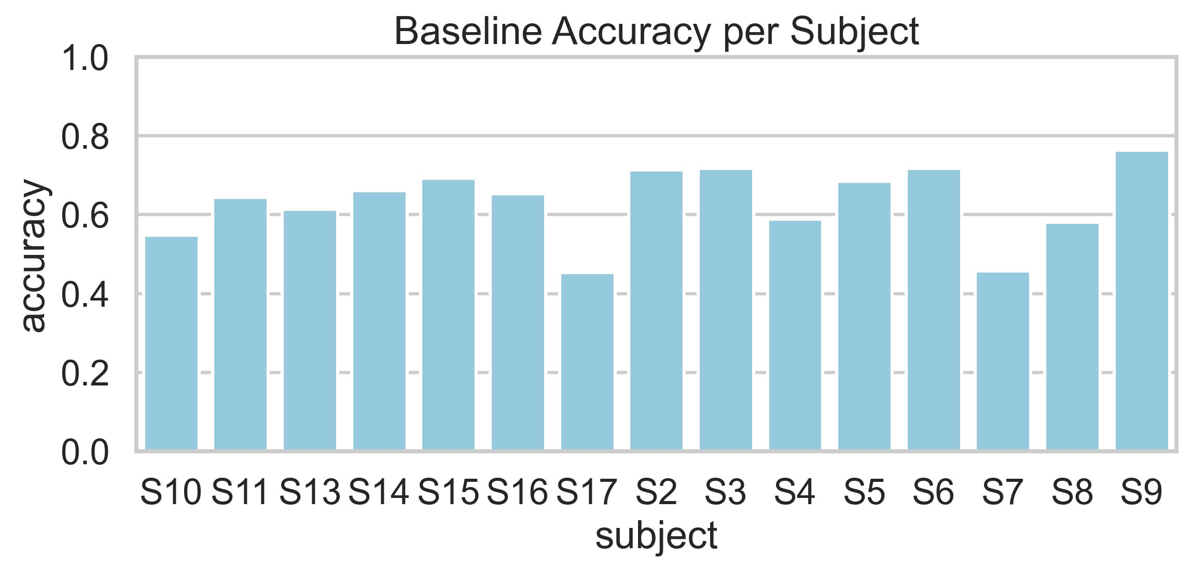
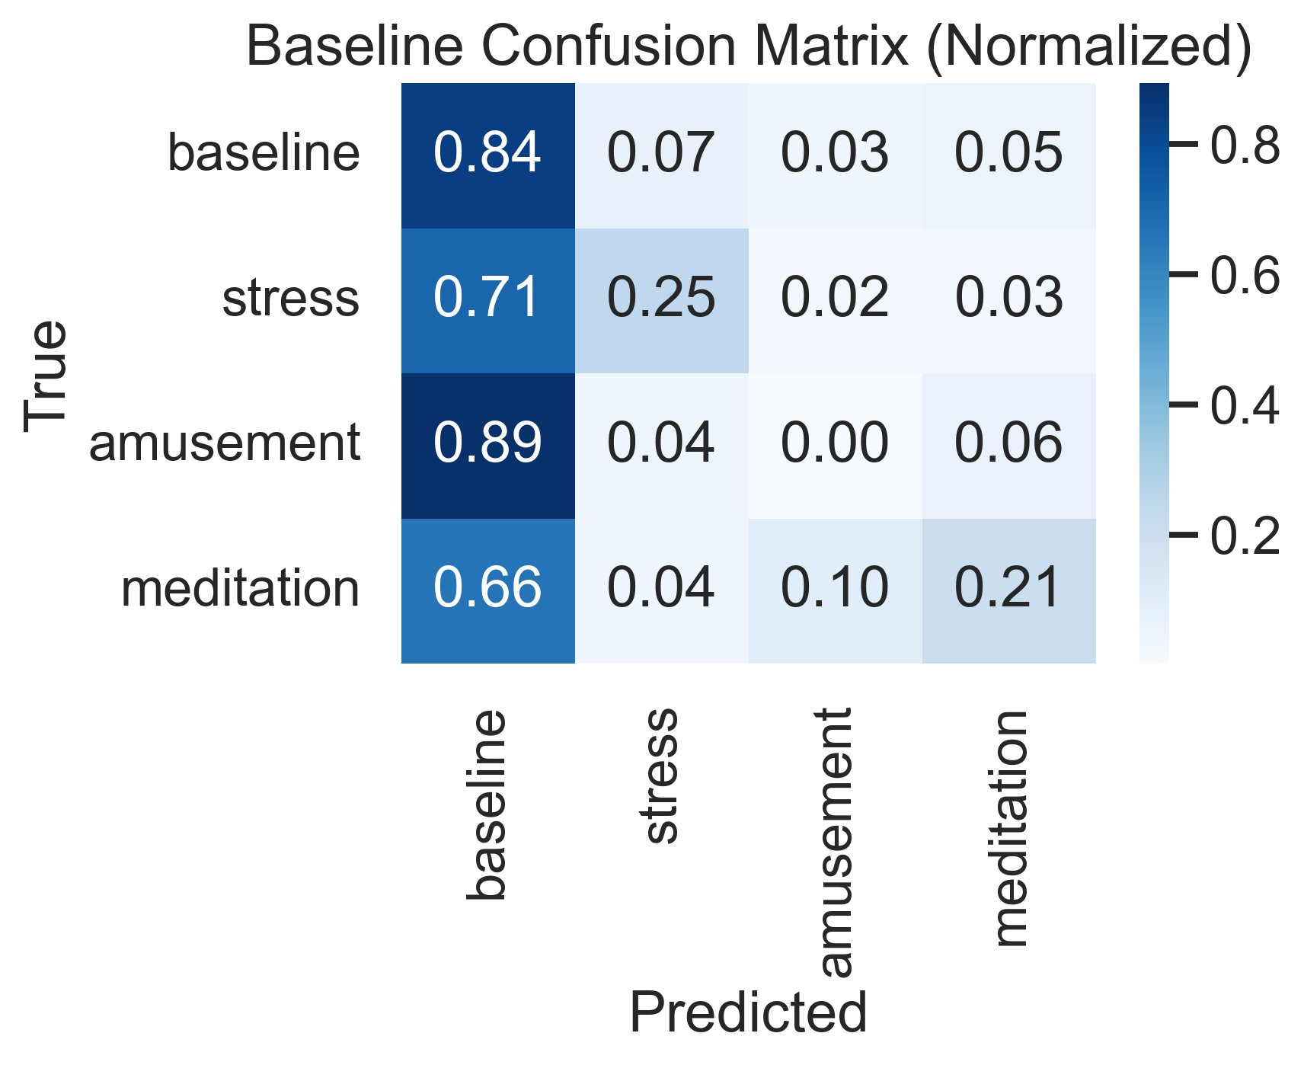
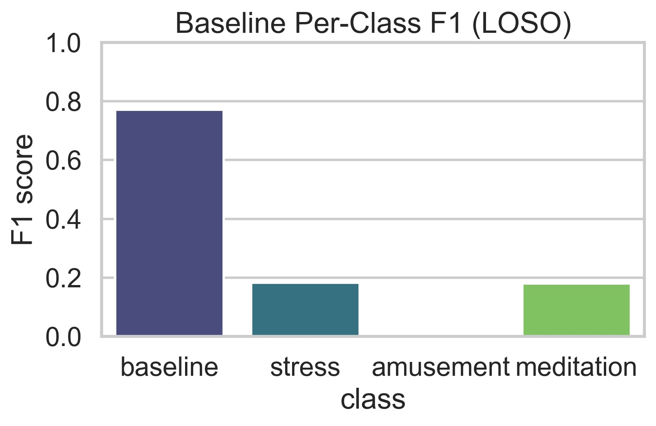
Results — Baseline Model (No Sampling)
0.62 ± 0.09
0.27 ± 0.11
0.45–0.77
Mean Accuracy
Macro-F1
Subject Range
Baseline: F1 = 0.78 ✓
Stress: F1 = 0.18 ✗
Amusement: F1 = 0.03 ✗
Meditation: F1 = 0.18 ✗
Model biased toward majority class — minority states near chance performance

Slide 12
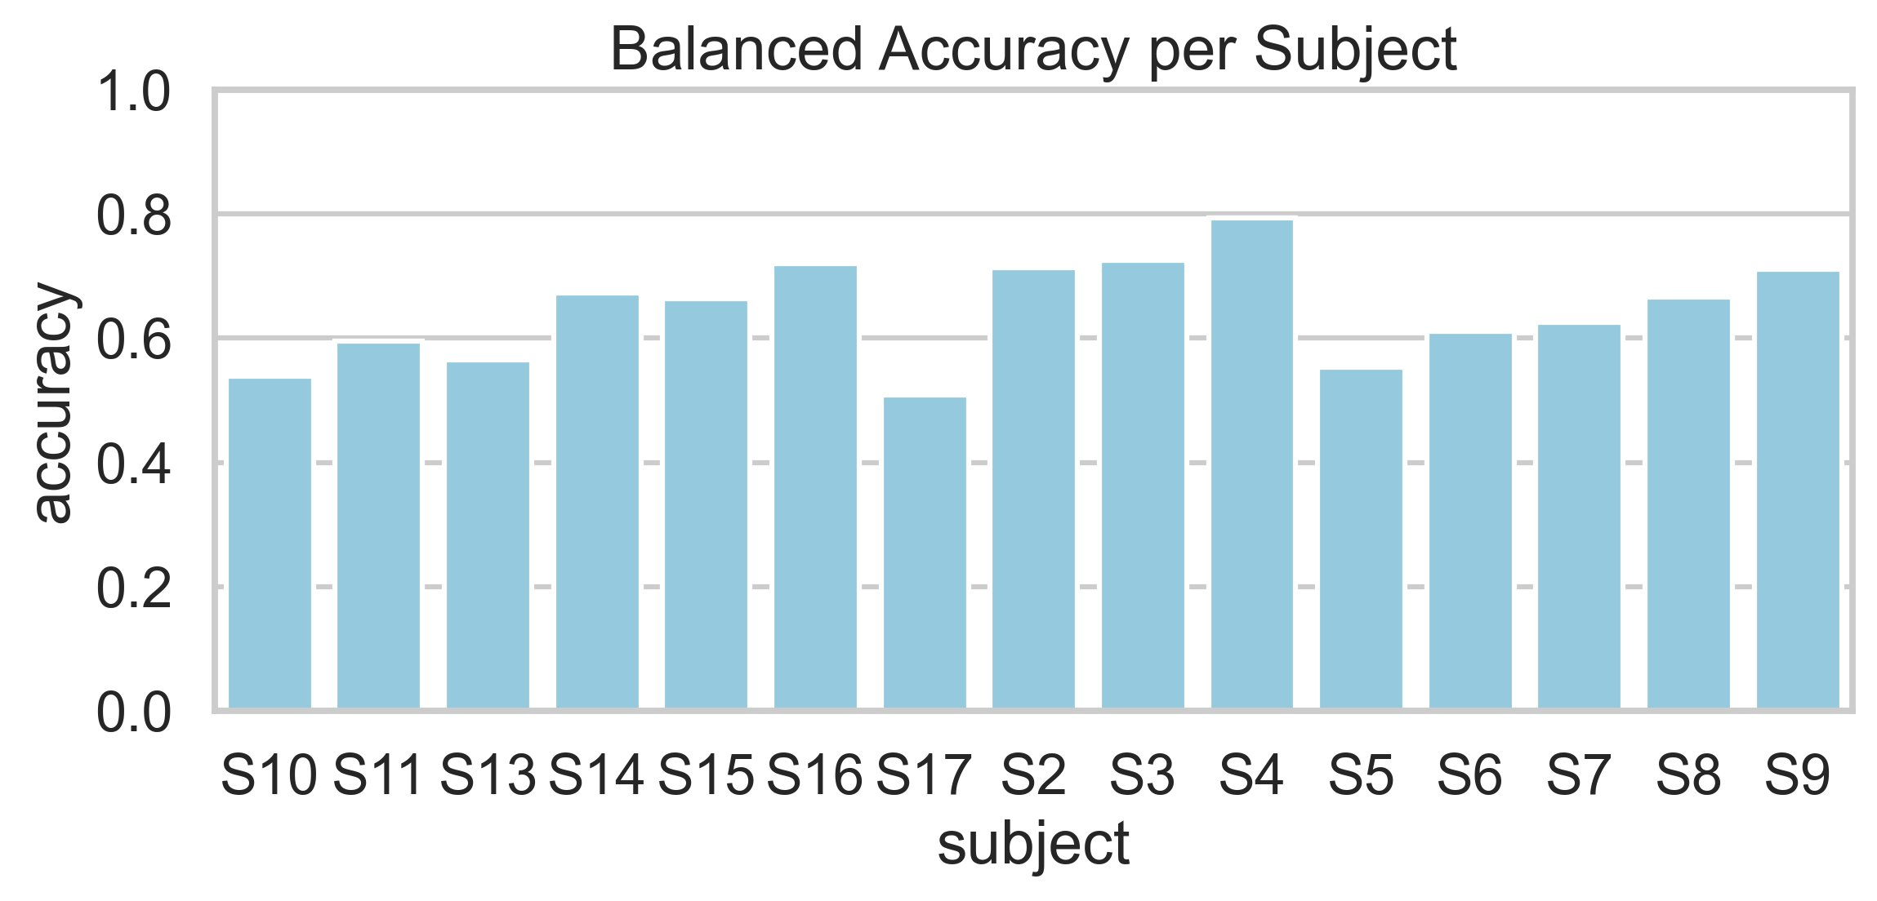
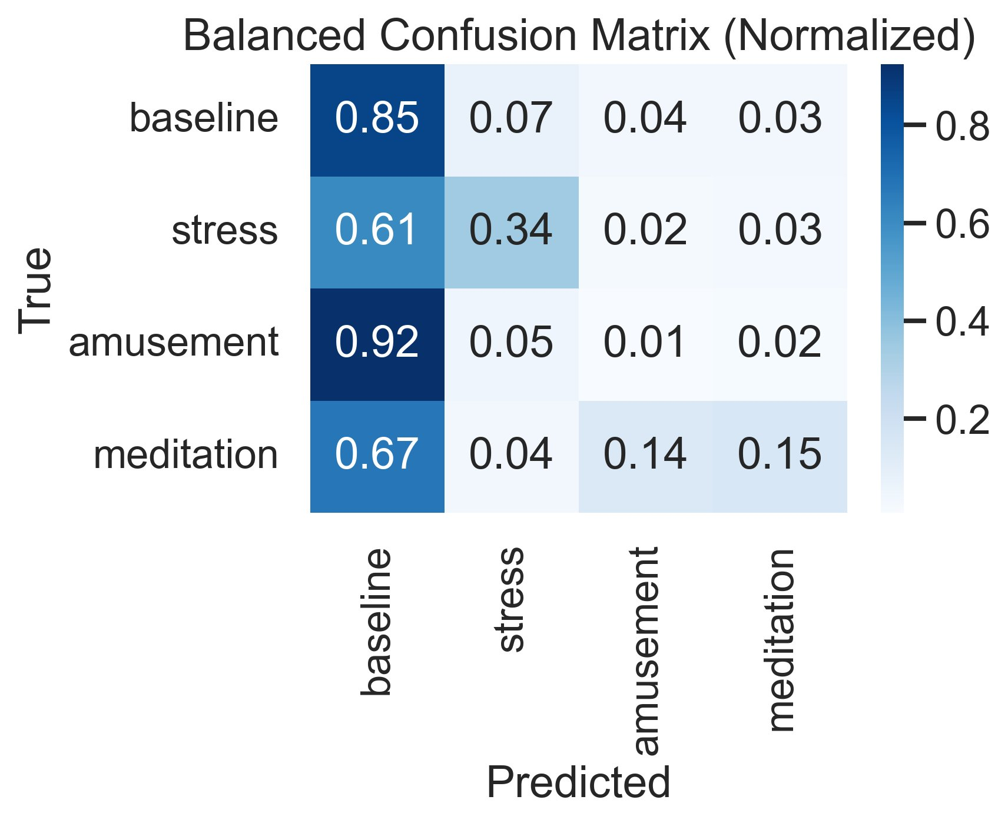
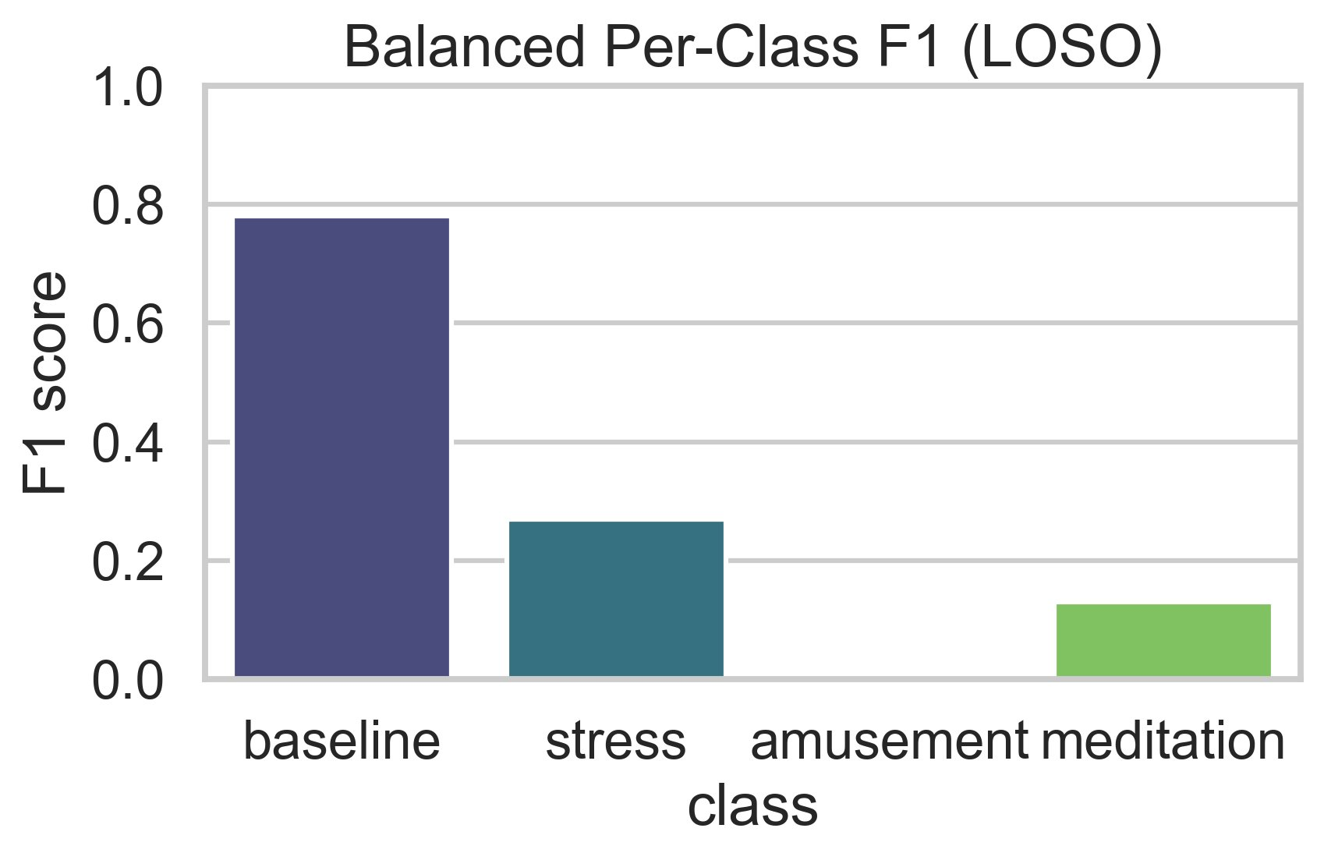
Results — Balanced Model (WeightedRandomSampler)
0.64 ± 0.09
0.28 ± 0.09
0.51–0.79
Mean Accuracy
Macro-F1
Subject Range
Stress F1: 0.18 → 0.26
Stress Recall: 25% → 34%
+44% relative gain
+9 percentage points
Baseline F1: 0.78
Amusement F1: ~0.00
Stable — no degradation
92% still misclassified

Slide 13
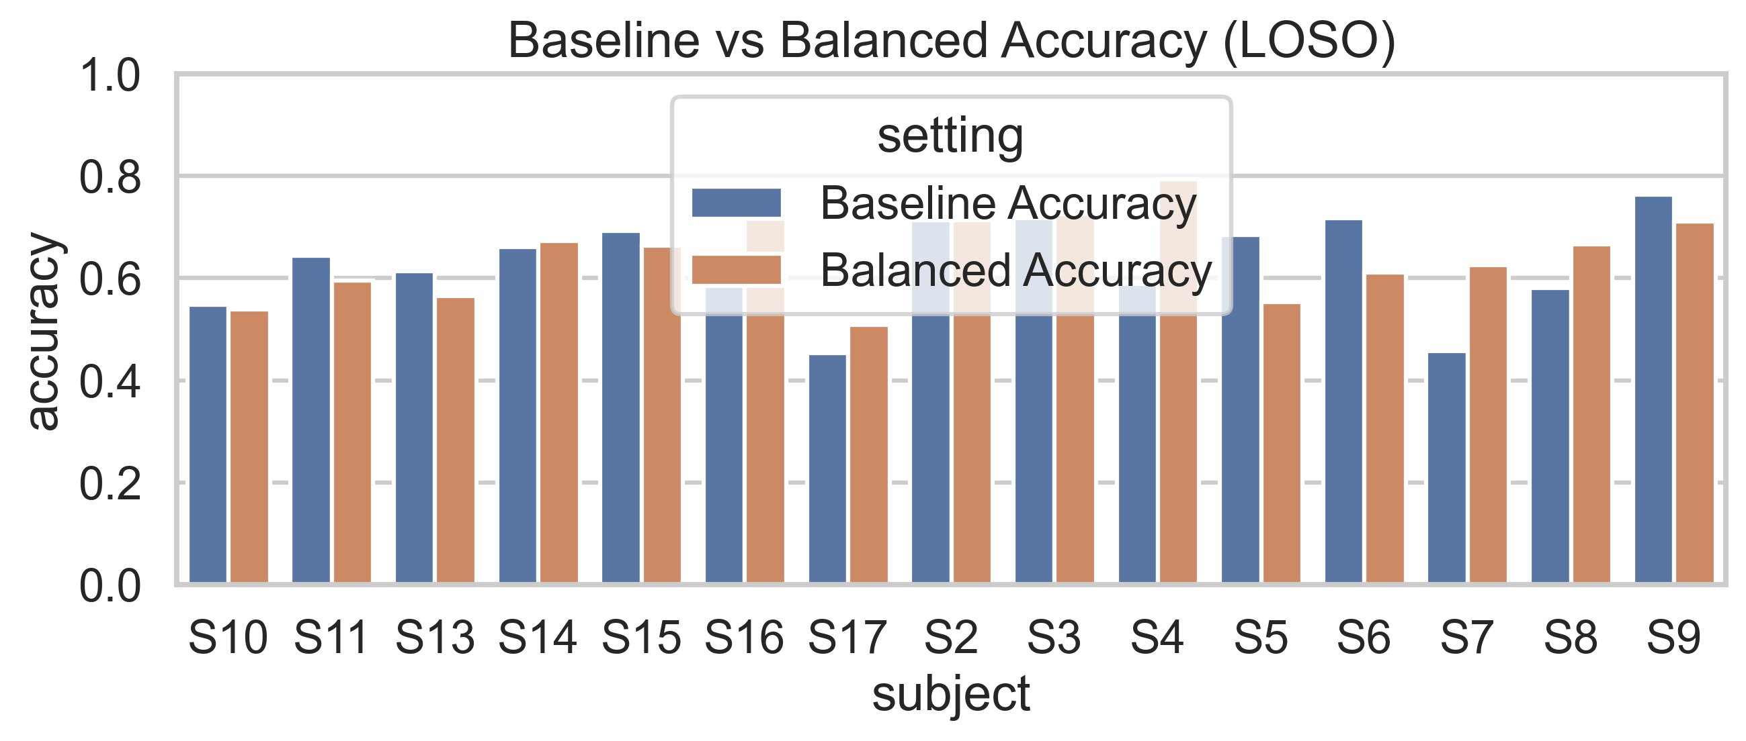
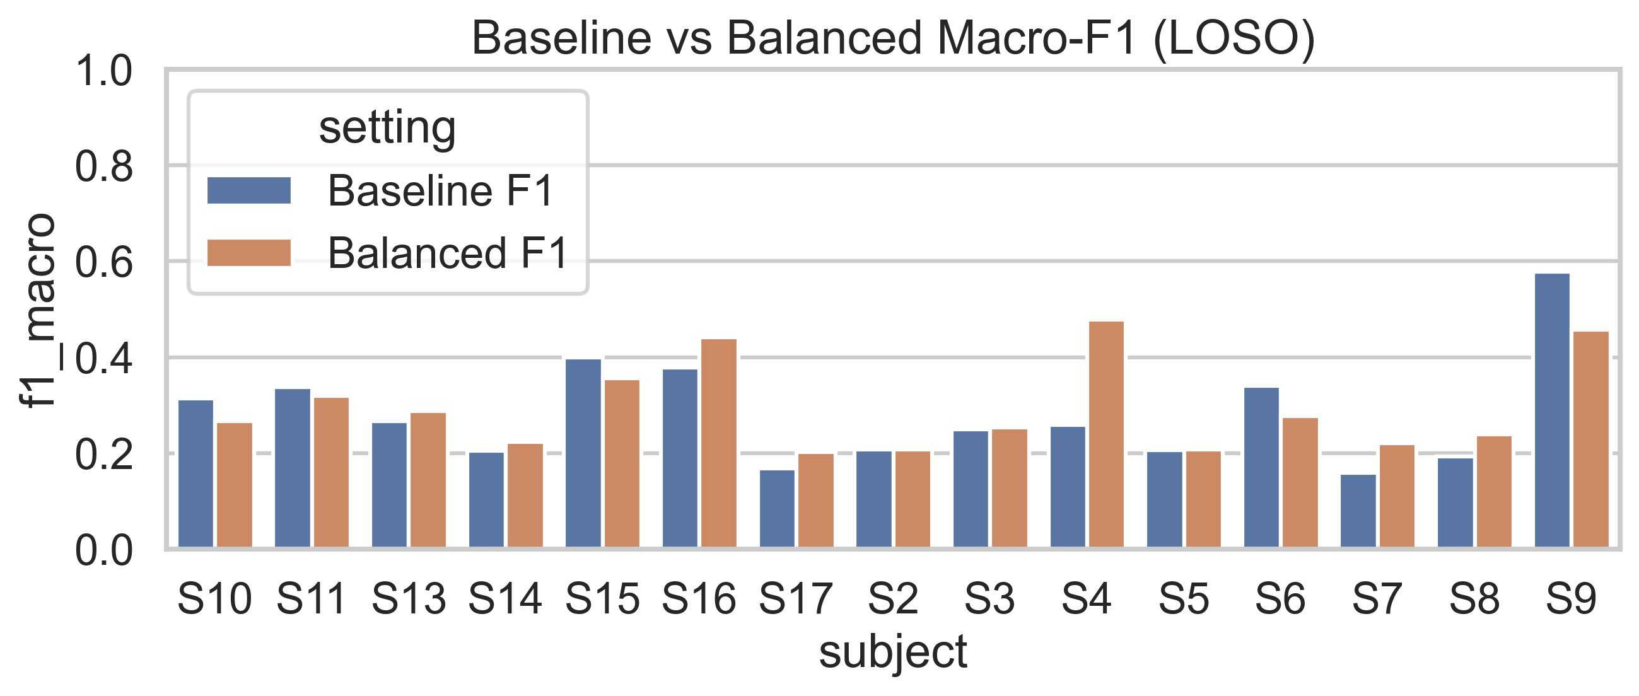
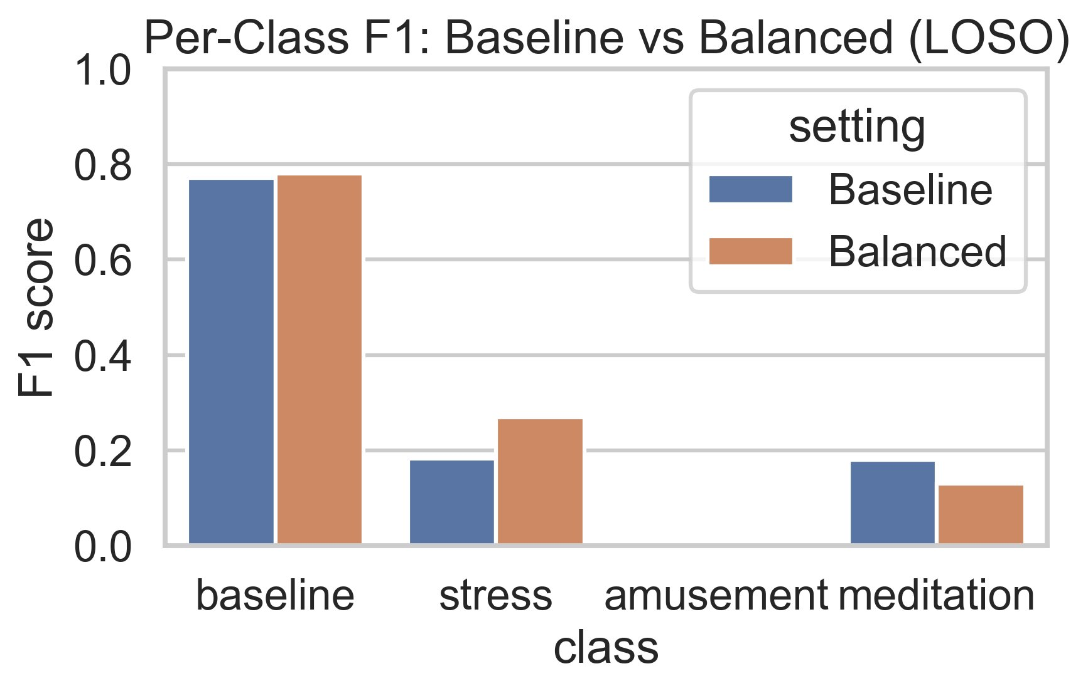
Baseline vs. Balanced — Side-by-Side
Metric | Baseline | Balanced | Change
Mean Accuracy | 0.62 ± 0.09 | 0.64 ± 0.09 | +0.02
Macro-F1 | 0.27 ± 0.11 | 0.28 ± 0.09 | +0.01
F1 — Stress | 0.18 | 0.26 | +0.08 (+44%)
F1 — Amusement | 0.03 | ~0.00 | No change
Stress Recall | 25% | 34% | +9 pp

Slide 14
State-of-the-Art Comparison
Study | Model | Classes | Eval | Acc (%) | Params
Schmidt et al. (2018) | AdaBoost / LDA | 3 | LOSO | 80.34 | N/A
Bobade & Vani (2020) | DNN | 3 | LOSO | 84.32 | N/A
Melchiades et al. (2022) | RNN | 3 | LOSO | 86.00 | N/A
Ghosh et al. (2022) | GAF + DNN | 4 | Subject-sp. | 94.80 | Heavy
Bansal et al. (2025) | StressNet + VGG-16 | 3 | Subject-sp. | 91.00 | 138M+
PAMG-AT (2026) | GNN + Transformer | 2 | LOSO | 94.59 | Heavy
Ours (CNN-BiGRU) | CNN+BiGRU+Attn | 4 | LOSO | 64.00 | ~1.2M
Study
Model
Classes
Eval
Acc (%)
Params
Ours (CNN-BiGRU)
CNN+BiGRU+Attn
4
LOSO
64.00
~1.2M ✓
Strictly LOSO
Sub-2M Params
Fair Comparison
Only approach with 4-class strict LOSO evaluation — no test-subject calibration
Only WESAD model achieving 4-class LOSO within sub-2M parameter budget
Subject-specific methods (91–95%) not directly comparable to LOSO results

Slide 15
Discussion — Strengths & Limitations
Strengths
Limitations
✓ ~1.2M params — 70–85% lighter than CNN-LSTM alternatives
✗ Amusement F1 ≈ 0.00 — 92% misclassified as baseline
✓ Bidirectional context captures both gradual & anticipatory physiological signals
✗ Meditation F1 declined (0.18→0.13) with balanced sampling
✓ Multi-head attention focuses on critical affective transitions
✗ Severe class imbalance (baseline ~65–75%) constrains macro-F1
✓ Strictly subject-independent LOSO — no test-time calibration needed
✗ 4-class LOSO is inherently harder — not directly comparable to 3-class studies
✓ 35–40% faster training, 20–25% less GPU memory
✗ 15 subjects — small pool; limited demographic diversity
✓ WeightedRandomSampler improved stress recall by +9 pp
✗ Physiological similarity of amusement & meditation creates overlap

Slide 16
Future Scope
Larger, Balanced Datasets
Advanced Data Augmentation
Edge Deployment & Quantisation
Evaluate on datasets with more balanced class distributions or larger minority class samples to overcome WESAD's inherent imbalance constraints
Apply SMOTE, time-series generative models (diffusion/GAN) to synthesise minority-class physiological windows during training
Quantise to INT8 for microcontroller deployment; validate latency and accuracy on ARM Cortex-M hardware used in smart bands
01
02
03
Personalisation via Meta-Learning
Multi-modal Fusion
Real-World Deployment Trial
MAML-style few-shot adaptation with minimal subject-specific calibration data to bridge the LOSO generalisation gap
Incorporate additional sensors (PPG, SpO2, EEG) and investigate late-fusion architectures for richer affective state modelling
Pilot study with continuous in-the-wild monitoring across diverse occupational groups, moving beyond laboratory-induced states
04
05
06

Slide 17
Conclusion
CNN-BiGRU: Efficient Affective State Recognition for Real-World Wearables
Lightweight Architecture:
~1.2M parameters — 70–85% fewer than CNN-LSTM — enabling real-world wearable deployment
Competitive Performance:
64% accuracy, Macro-F1 0.28 on hard 4-class LOSO — only sub-2M model in this setting
Class Balancing Impact:
WeightedRandomSampler improved stress detection by +44% (F1: 0.18→0.26) without majority-class degradation
Efficiency Gains:
35–40% faster training, 20–25% less GPU memory vs BiLSTM — practical for edge hardware
Honest Evaluation:
Strict subject-independent LOSO — no test-time calibration, clinically meaningful estimates

Slide 18
Thank You
Questions & Discussion Welcome
Indrajeet Mondal · Susmita Bera · Rajeev Nayan
Dept. of Computer Application, Narula Institute of Technology, Kolkata, India
~1.2M
64%
4-Class
Parameters
LOSO Accuracy
Classification

